Slide 1

CRUD Operation
(MVC Framework – CODEIGNITER)
Group: 9

Slide 2
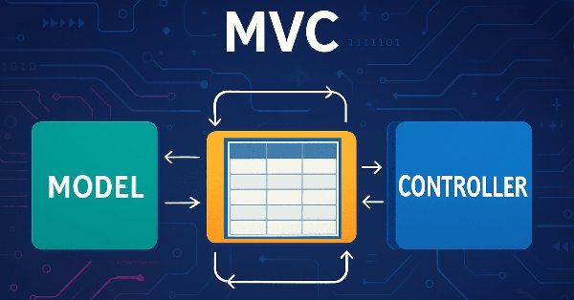
Introduction to the Model-View-Controller (MVC) Architectural Pattern
MVC is an architectural pattern that separates an application into three main logical components: the Model, the View, and the Controller. This separation of concerns simplifies development, improves maintainability, and enhances scalability, especially for complex web applications.
Model
View
Controller
Manages the data and business logic of the application. It interacts directly with the database, handling data retrieval, storage, and manipulation.
Presents the data to the user. It's responsible for the user interface (UI) and displays information based on the Model's data.
Acts as an intermediary between the Model and the View. It receives user input, processes it, updates the Model, and selects the appropriate View to display.

Slide 3

Implementing the Create Operation in CodeIgniter MVC
The 'Create' operation involves adding new data records to your database. In CodeIgniter, this typically involves a form in the View to collect user input, a Controller to handle the submission, and a Model to interact with the database's insert function.
View: Data Input Form
Controller: Handle Form Submission
Design an HTML form to gather the necessary data from the user (e.g., name, email).
Receive the form data, validate it, and prepare it for insertion. This acts as the bridge between the user and the database.
Model: Database Insertion
Feedback: User Confirmation
Call a Model method to execute the database insert query. CodeIgniter's Active Record simplifies this process significantly.
After successful insertion, redirect the user or display a success message.

Slide 4
Implementing the Read Operation in CodeIgniter MVC
The 'Read' operation is about retrieving data from your database. This could involve fetching all records, a single record based on an ID, or filtered records. CodeIgniter's Model is crucial here for querying the database, while the View displays the results to the user.
Controller: Request Handling
Model: Data Retrieval
The Controller receives a request to display data (e.g., a URL for a list of users).
A Model method queries the database to fetch the requested data. This might involve using conditions, sorting, or limiting results.
Controller: Prepare Data for View
View: Display Data
The retrieved data is passed from the Model back to the Controller, which then prepares it for rendering.
The View component takes the prepared data and presents it in a user-friendly format, often in tables or lists.

Slide 5
Implementing the Update Operation in CodeIgniter MVC
The 'Update' operation allows modifications to existing data records. This is a two-step process: first, fetching the existing data to populate an edit form, and second, processing the submitted form to save the changes back to the database.
1. Displaying Data for Edit
2. Processing the Update
Controller fetches the specific record using its ID.
Controller receives the submitted form with modified data.
Model retrieves the data from the database.
Data validation is performed to ensure integrity.
View populates an edit form with the fetched data.
Model executes the update query against the database using the record's ID.
User receives confirmation of the update.

Slide 6
Implementing the Delete Operation in CodeIgniter MVC
The 'Delete' operation is used to remove data records from the database. This is often the simplest CRUD operation to implement but requires careful consideration to prevent accidental data loss. Confirmation steps are highly recommended.
Controller: Delete Request
User Confirmation
A request to delete a record (usually via an ID) is sent to the Controller.
It's vital to prompt the user for confirmation before proceeding with deletion to prevent accidental data loss.
Model: Database Deletion
Redirect/Feedback
The Model executes the database delete query, typically based on a unique identifier.
After deletion, the user is redirected or shown a success message.

Slide 7
THANK YOU!

